Slide 1
Functions
A function is a Reusable block of code that performs a specific task.

Slide 2
Types of function
There are two types of function in C programming:
Standard library functions
User-defined functions

Slide 3
Standard library functions
The standard library functions are built-in functions in C programming.
These functions are defined in header files. For example, The printf() is a standard library function to send formatted output to the screen (display output on the screen). This function is defined in the stdio.h header file.

Slide 4
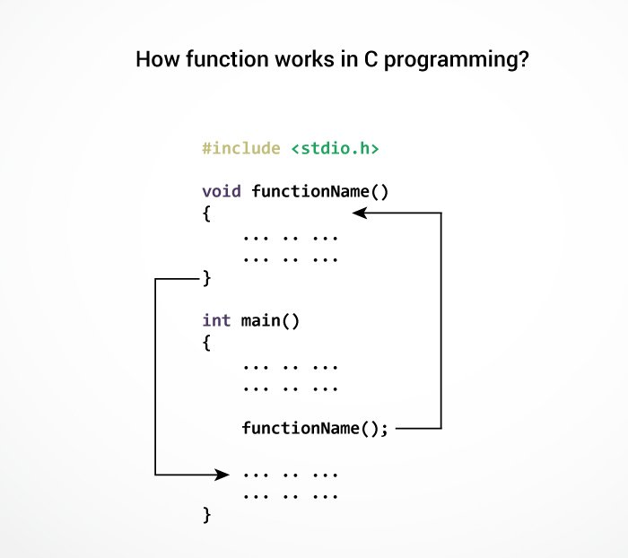
User Defined functions
We can also create functions as per your need. Such functions created by the user are known as user-defined functions. Function names are identifiers and should be unique.

Slide 5
Advantages of user-defined function
The program will be easier to understand, maintain and debug.
Reusable codes that can be used in other programs
A large program can be divided into smaller modules. Hence, a large project can be divided among many programmers.

Slide 6
Function prototype
A function prototype is simply the declaration of a function that specifies function's name, parameters and return type. It doesn't contain function body.
A function prototype gives information to the compiler that the function may later be used in the program.
returnType functionName(type1 argument1, type2 argument2, ...);

Slide 7
Calling a function
Control of the program is transferred to the user-defined function by calling it.
functionName(argument1, argument2, ...);

Slide 8
Function Definition
Function definition contains the block of code to perform a specific task. For example, adding two numbers and returning it.
returnType functionName(type1 argument1, type2 argument2, ...) { //body of the function }

Slide 9
Types of user defined functions
No Argument Passed and No Return Value
No Arguments Passed But Returns a Value
Argument Passed But No Return Value
Argument Passed and Returns a Value

Slide 10
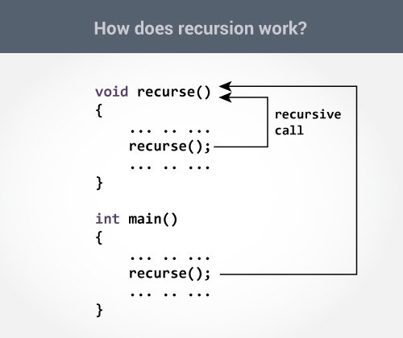
Recursion in C
A function that calls itself is known as a recursive function. And, this technique is known as recursion.

Slide 11
Example of recursive function

Slide 12
